Slide 1
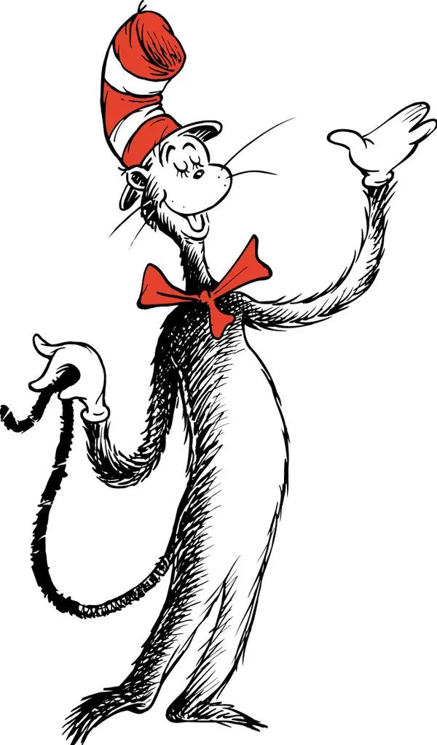
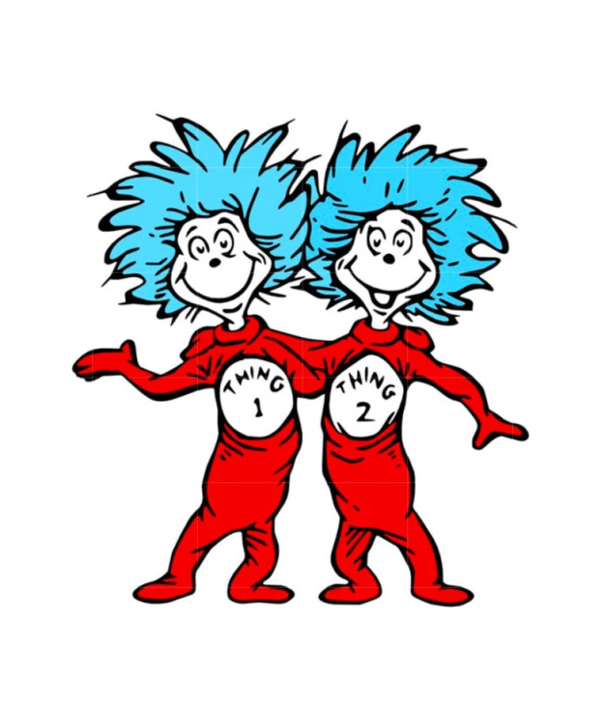
What do you think the Cat in the Hat and Thing 1 and Thing 2 would say if they came to your house?
Name:

