Slide 1
Let’s Learn About Insects and Use Technology in Computer Class!
Name:

Slide 2
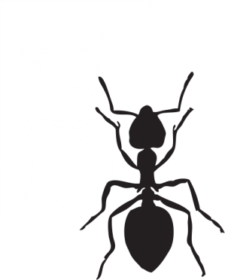
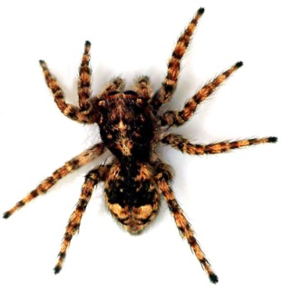
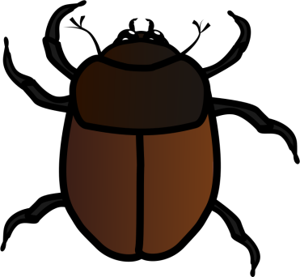
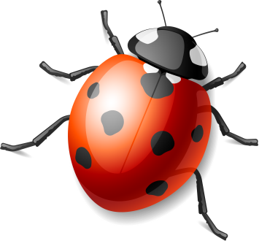
Insects have 6 legs. Delete the pictures that are not insects.

Slide 3
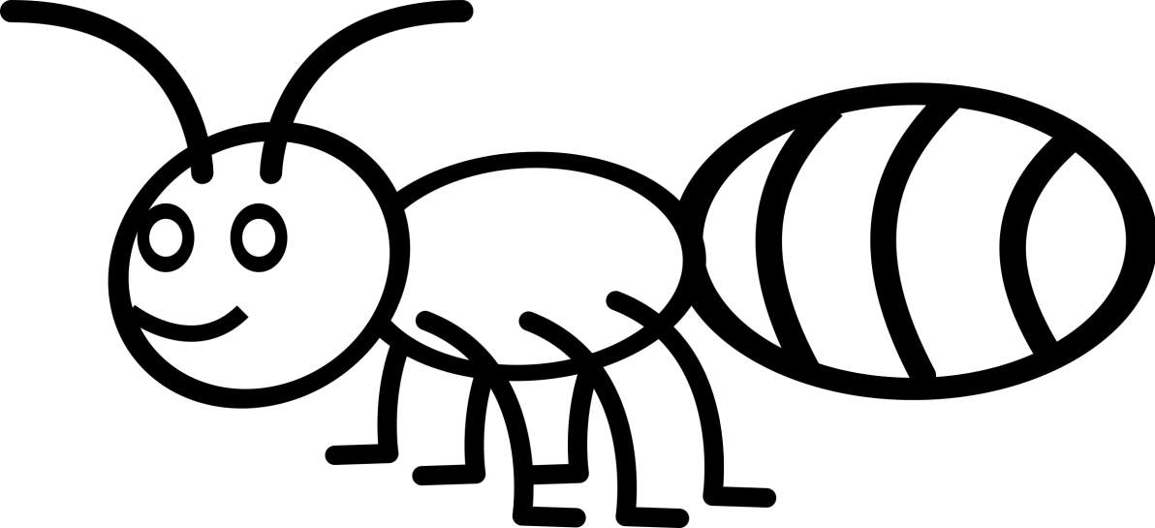
Insects have a head, a thorax, and an abdomen. Drag the arrow to point at the right part.
thorax
abdomen
Head

Slide 4
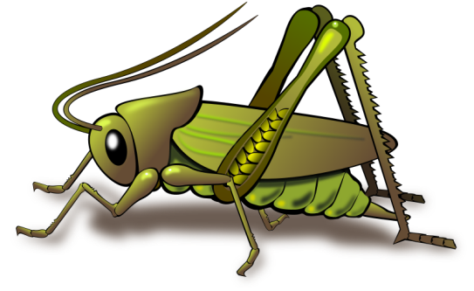
Drag the corner of the picture to make the boy big and the insect little.

Slide 5
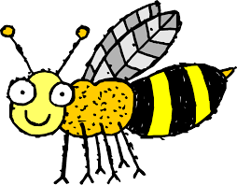
Type one sentence about this insect.

Slide 6
Insert a clip art picture of an insect.

